Slide 1
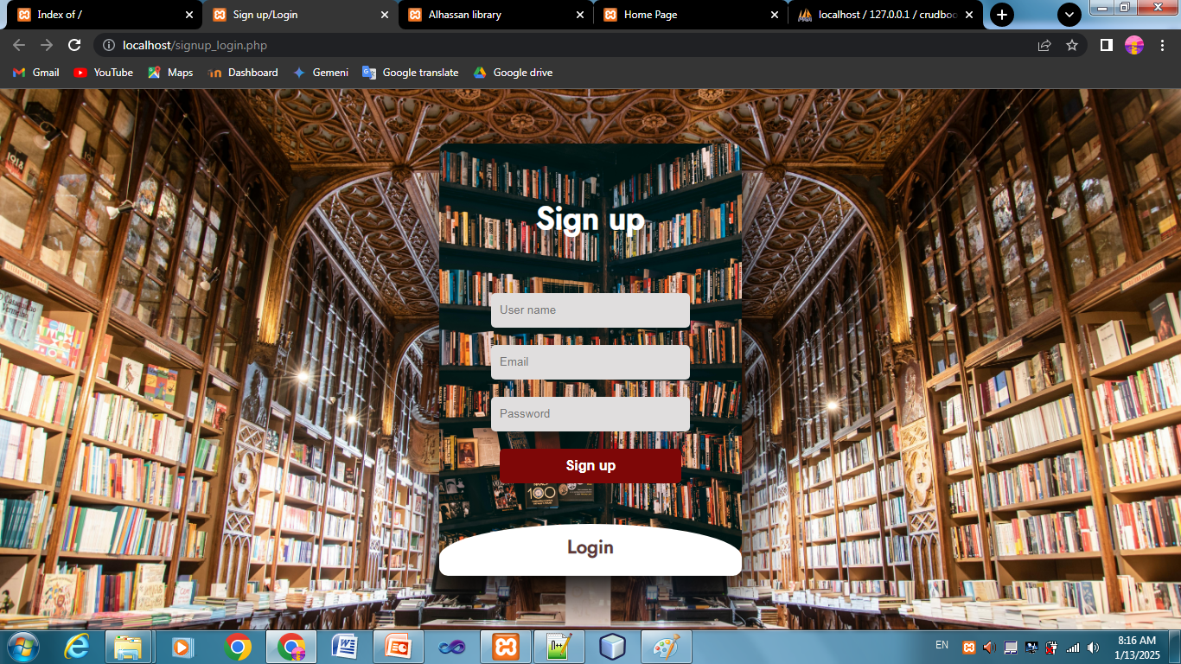
Sign up/Login

Slide 2
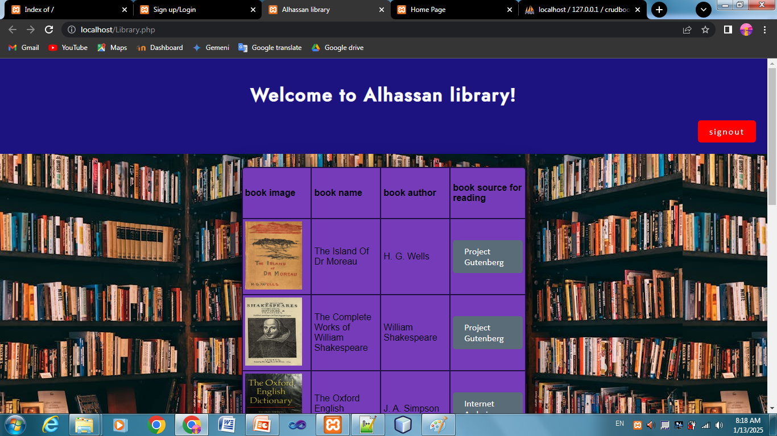
Library Page

Slide 3
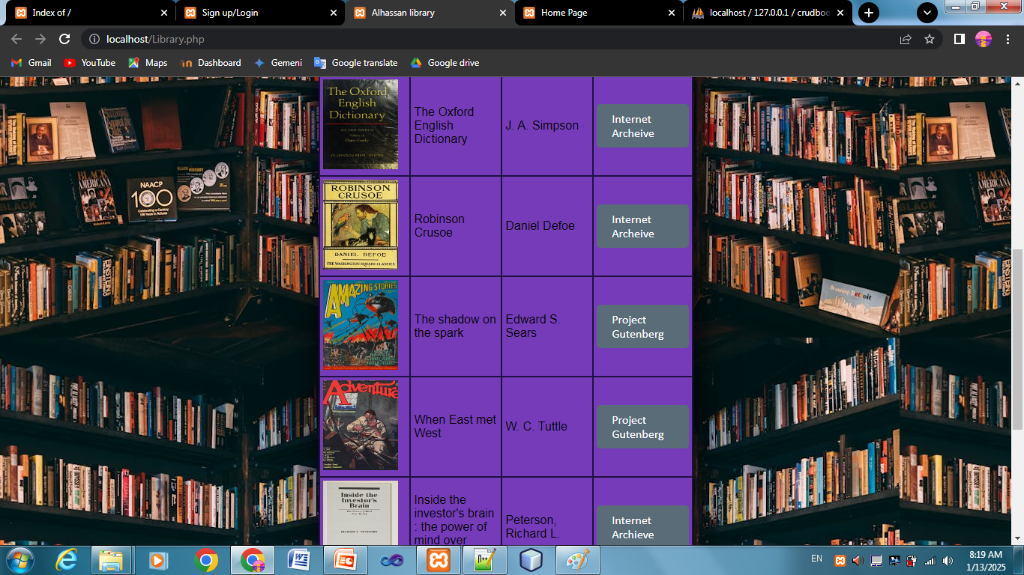
Library Page

Slide 4
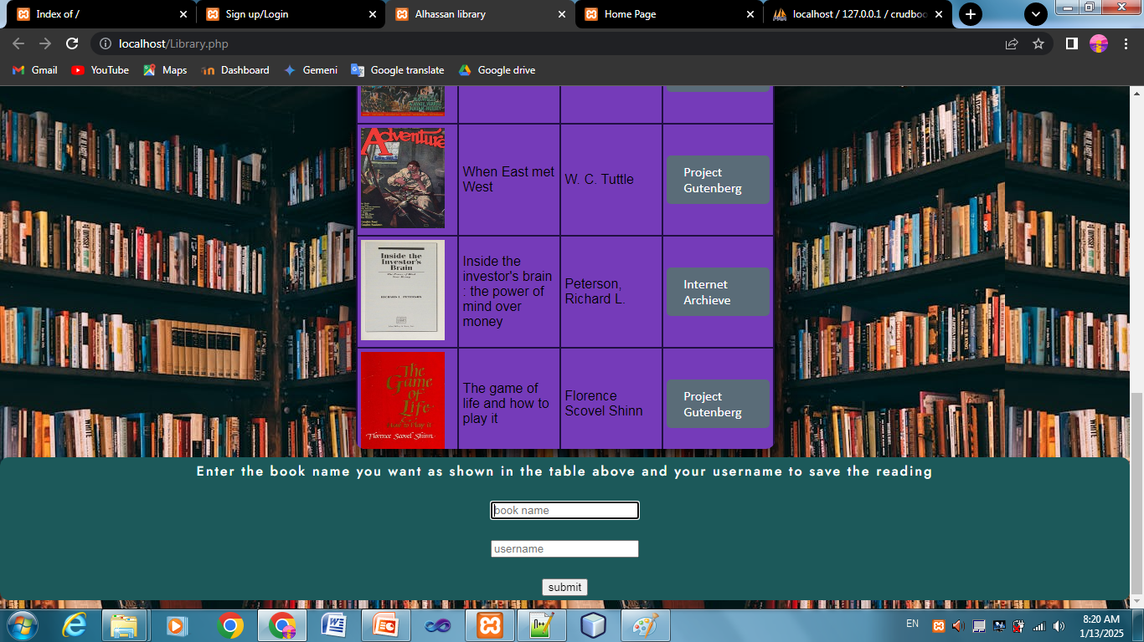
Save the reading by enter username and book name

Slide 5
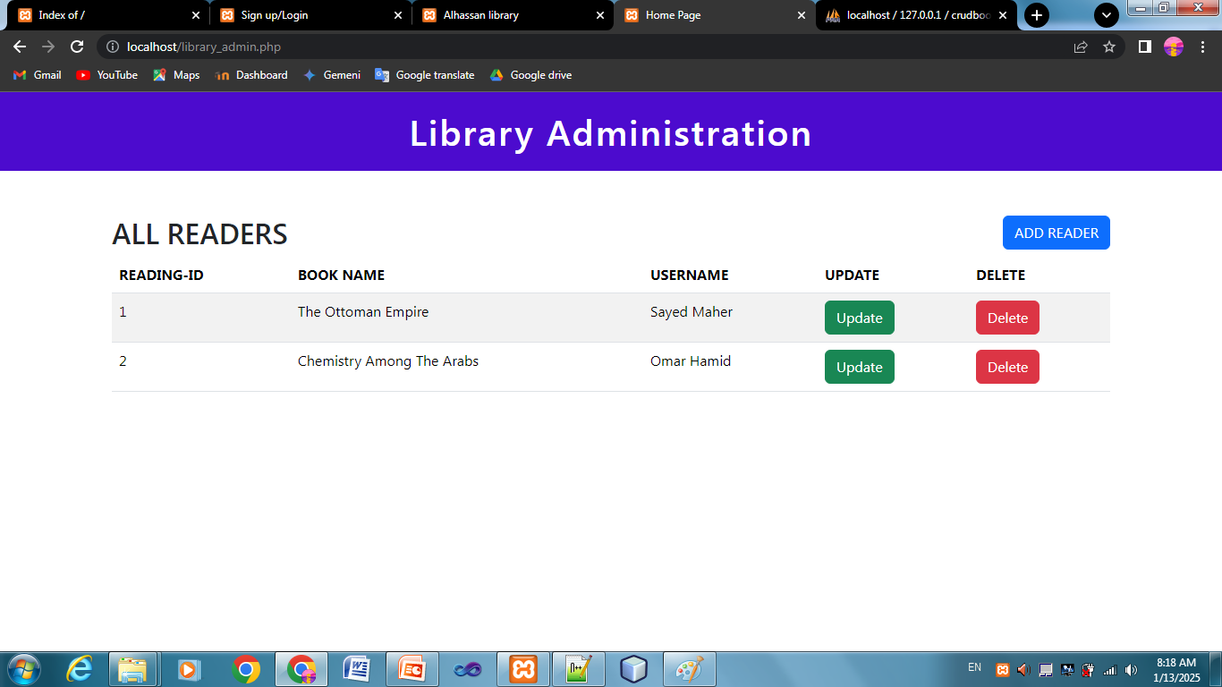
Administration Dashboard/ Dashboard

